Slide 1
Concrete Goods and Basic Needs Supports for Families in Child Welfare
Jesse Stigile | Community Support Services Manager
Department of Children, Youth, and Families (DCYF)
August 28, 2025

Slide 2
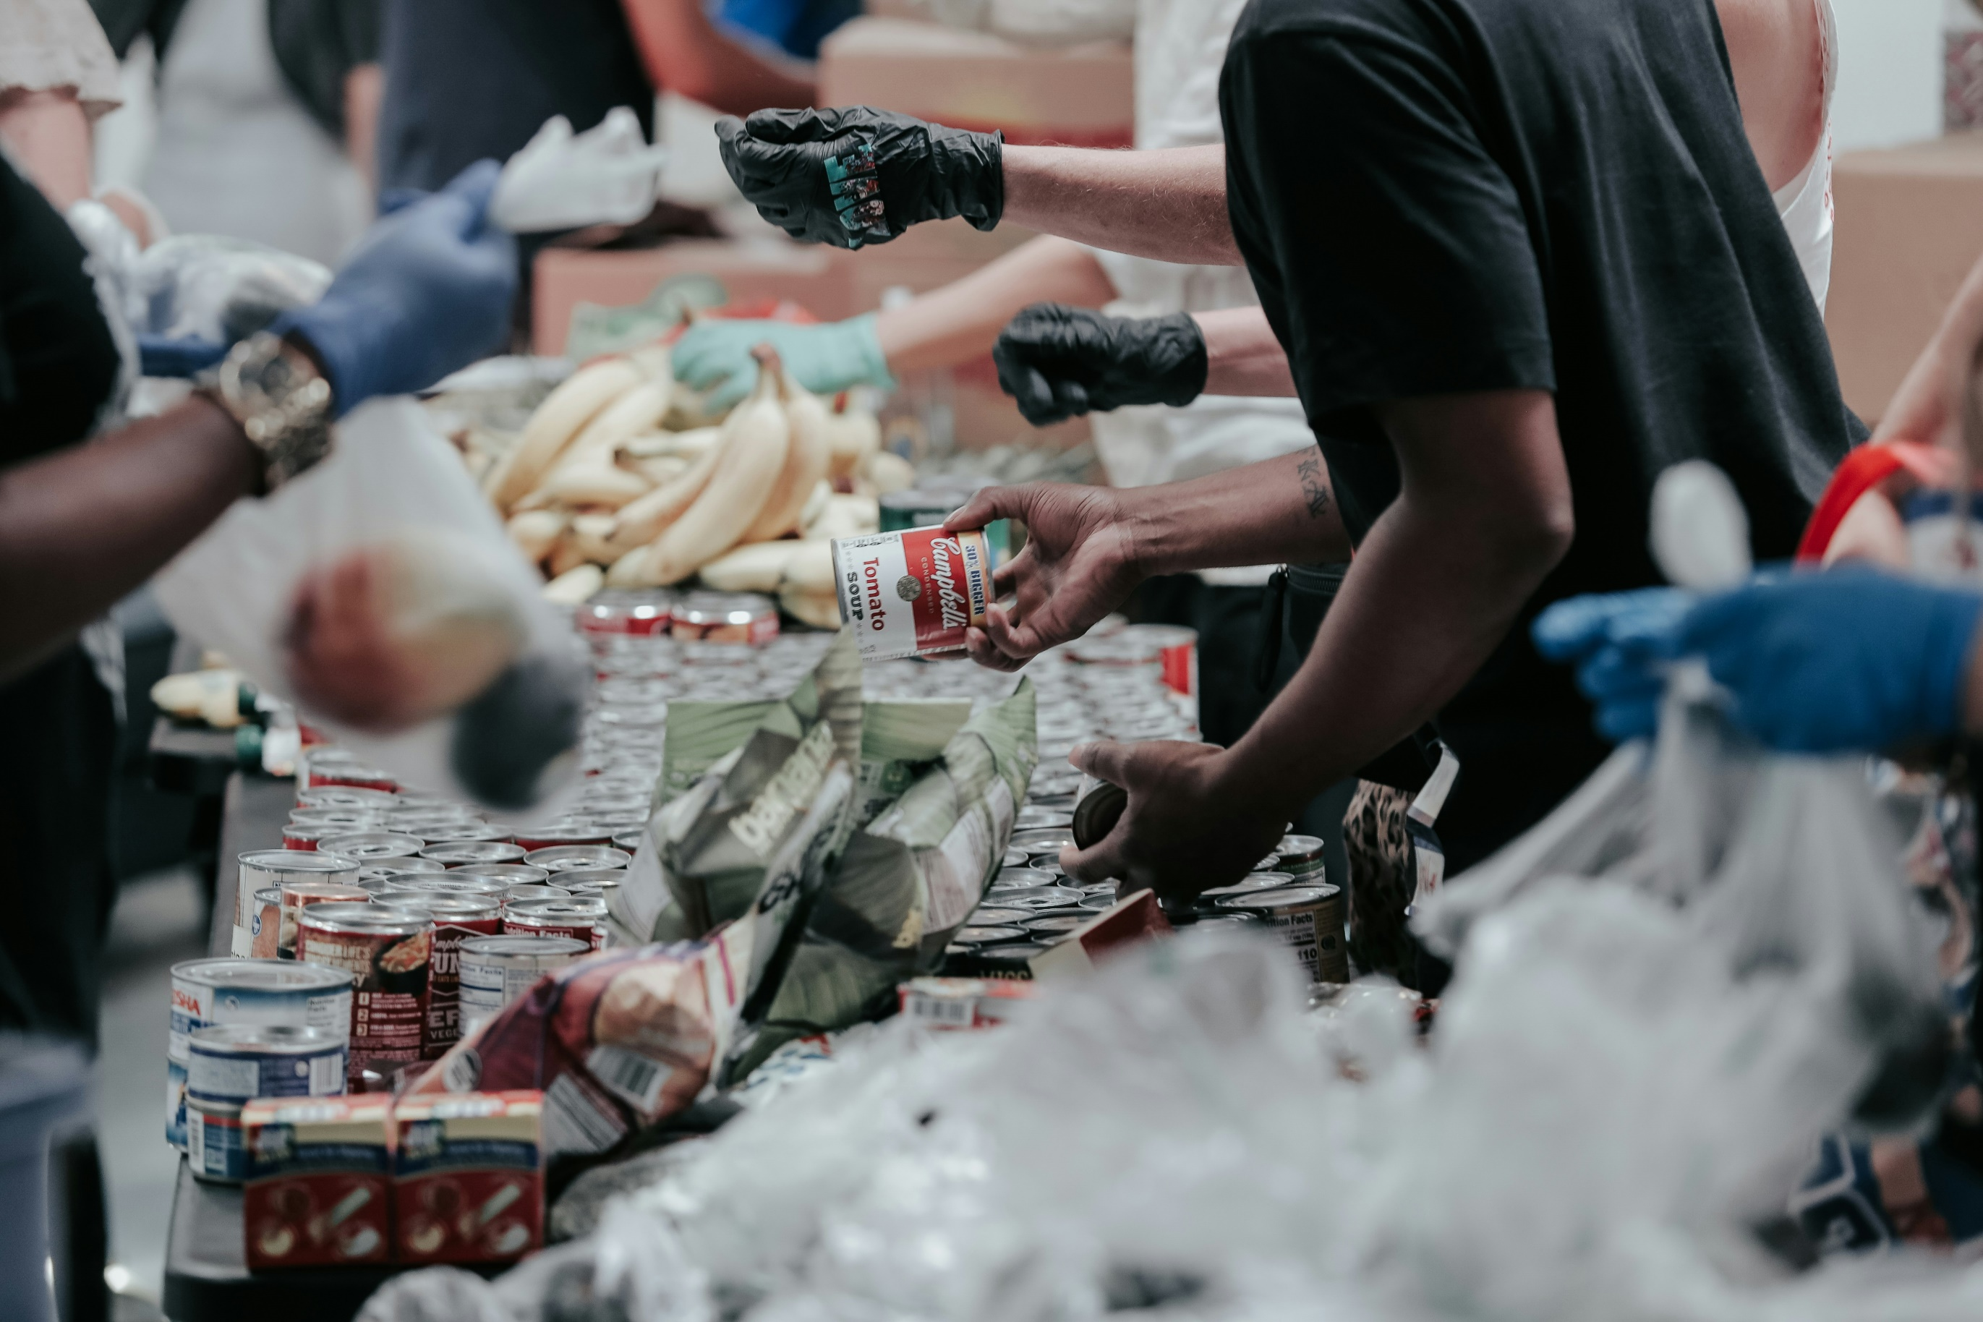





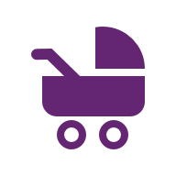



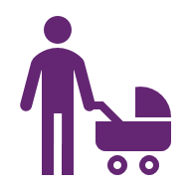
What are Basic Needs?
The essential, fundamental goods and resources that all families need to sustain daily living. Access to basic needs is foundational for families to flourish and children to thrive.
Housing and Furniture
Safety Items
Food and grocery
Utilities
Communication
Pregnancy & Baby Supplies
Clothing and Hygiene
Transportation
Healthcare
Child Care

Slide 3




Material hardship is among the strongest predictors of child welfare involvement.
Income losses, cumulative material hardship, and housing hardship are the most reliable predictors of child maltreatment.
Low-income families experiencing at least one type of material hardship are approximately 3x more likely to receive a neglect investigation and 4x more likely to receive a physical abuse investigation (increases to 4x and 7x respectively for families experiencing multiple types of hardship).
Optional: For more information on the relationship between material hardship and Child Welfare involvement, see:
Child and Family Well-being System: Economic & Concrete Supports as a Core Component
Can’t pay rent or mortgage
Needed medical care, but didn’t go
Food insecure
Can’t pay gas, oil, or electricity bill

Slide 4
Concrete support in times of need is a well-evidenced Child Welfare protective factor.
Childcare, housing supports, affordable health care, and flexible funds for concrete needs all demonstrate positive reductions in Child Welfare involvement.
Services that offer concrete supports are more effective than those without. Child Welfare families who receive a home-based service with concrete supports are 17% less likely to experience a subsequent child maltreatment report than families who receive the same service without supports.

Slide 5
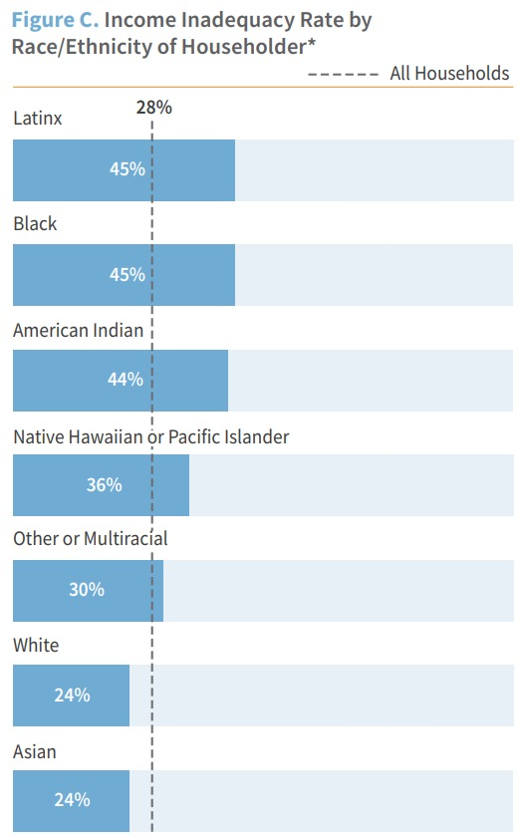
BIPOC families are disproportionality impacted by economic hardship.
Maltreatment risk is more than 5 times higher nationally for children in families with low socioeconomic status.
In Washington, Black, Indigenous, and Latinx families are 1.9 times more likely than White families to fall below the Washington Self-Sufficiency Standard for meeting basic needs.
Maltreatment disproportionality is mitigated when controlling for racial poverty. At high child poverty rates (> 15%) White families demonstrate maltreatment rates similar to or higher than those of Black and Hispanic/Latinx families.
The Self-Sufficiency Standard for Washington defines the amount of income necessary to meet basic needs of Washington families, differentiated by family type and where they live.

Slide 6
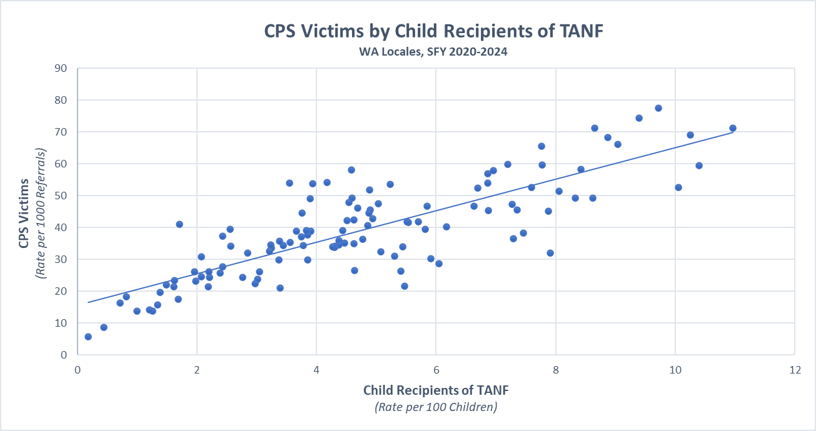

Slide 7
DCYF is 4.4 times more likely to receive a referral that results in a finding of abuse or neglect from communities with high rates of children in financially needy households than communities with low rates of financial need.
Washington Locale | Child TANF Rank | CPS Victim Rank
Longview | 1 | 3
Bickleton, Goldendale, Mabton, Mount Adams | 3 | 5
Aberdeen, Cosmopolis, Hoquiam | 5 | 1
Kelso | 6 | 2
Spokane | 7 | 7
Centralia | 8 | 6
Asotin-Anatone, Clarkston | 9 | 4
High TANF Enrollment : High Rates Abuse and Neglect
Of Washington’s top 10 locales with the highest child TANF enrollment, 7 are also represented among locales with the top ten highest CPS victim rates. (Communities illustrated in the table to the right).
Low TANF Enrollment : Low Rates of Abuse and Neglect
Of Washington’s top 10 locales with the lowest child TANF enrollment, 9 are also represented in the top 10 lowest CPS victim rates. (Mercer Island, Bainbridge Island, Riverview/ Skykomish, Snoqualmie Valley, Northshore, Issaquah, Lake Washington, Camas/Hockinson, Snohomish)

Slide 8







Concrete Goods in Child Welfare Programming
Short-term economic assistance distributed by Child Welfare caseworkers to families to temporarily alleviate material hardship, while referring to state and community-based resources.
Up to 60 days per referral
CPS, FAR, FVS/FRS, CFWS, EFC
Safety, Well-Being, Stability, Reunification
Referral Approvals:
Caseworker: Up to $500
Supervisor: $501 - $1000
Area Administrator: $1001 - $2000
RA or RA Designee: $2000 +
Caseworker Concrete Goods Guide
Housing and Furniture
Safety Items
Food and grocery
Utility Assistance
Baby Essentials
Clothing
Transportation
Cleaning and Storage

Slide 9




Child Welfare Concrete Goods Distribution Pathways
Office Inventory
Gift Card/Voucher
Direct Ship
Service Payment
Quick access items available on-site at each DCYF office
Vouchers and gift cards for purchasing goods and services
Large items shipped directly to the home or items needing on-site set-up
Paid directly to the service provider (e.g., landlord, mechanic)

Slide 10
Concrete Goods through In-Home Services
Goods and services distributed by contracted In-Home Service Providers to engage families, strengthen access to services, and support child safety, well-being, and permanency outcomes.
Family Preservation Services
Project SafeCare
Intensive Family Preservation Services (Homebuilders)
Promoting First Relationships
In-Home Service Providers:
$75 for family engagement; up to $500 per case as approved by Caseworker.
CIHS Provider Concrete Goods Guide
Functional Family Therapy
Incredible Years
Positive Parenting Program (Triple P)
Parent Child Interaction Therapy

Slide 11
Concrete Goods to Low-Income Families Community-Based Prevention
In State Fiscal Year 2024 (SFY24), 87 organizations provided approximately $1.9 million in concrete goods to 59,820 families across the state. Various organizations, including early learning programs, family resource centers, food banks, and social service organizations purchased and distributed concrete goods to low-income families.
Goods Provided SFY22-SFY24
Grocery Cards, Groceries, Food | Gas, Bus Passes, Transportation, Auto Repair | Diapers and Baby Supplies | School Supplies
17,738 | 3,264 | 119,321 | 34,291
Other Gift Cards | Cleaning Supplies | Hygiene Supplies | Clothes
9,113 | 3,872 | 42,907 | 10,007

Slide 12
Other DCYF Housing and Basic Needs Supports for Families in Child Welfare
Child Welfare Housing Program
Housing vouchers, temporary rental assistance, housing navigation, and case management supports for families with an open child welfare case when lack of adequate housing is contributing to a child’s risk of out-of-home placement or a barrier to family reunification.
Child Welfare Continuing Child Care
Up to 12 months of free child care for families with an open Child Welfare case or a Child Welfare case that closed within the past six months.

Slide 13
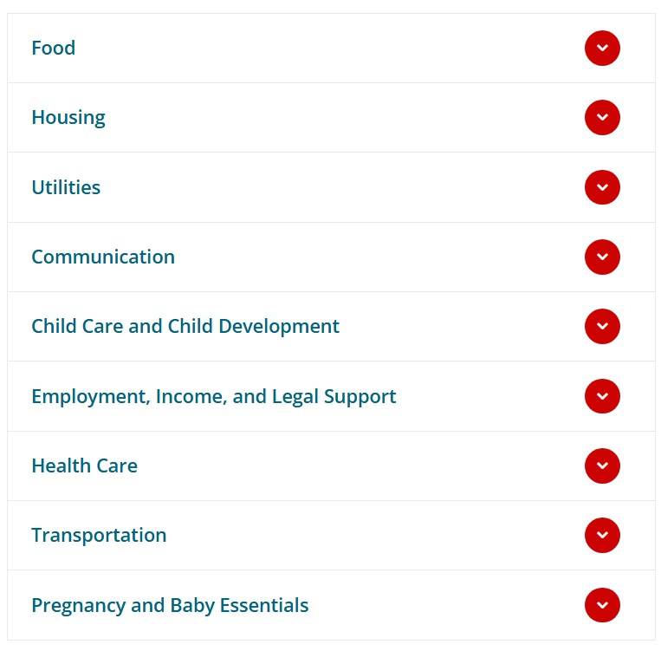
DCYF Basic Needs Community Resource Directory
Explore the Basic Needs Community Resource Directory for statewide and community-based resources for families experiencing limited access to food, stable housing, transportation, child care, and other essentials.
Help Me Grow Washington
Child Care Aware of Washington
Washington Connection

Slide 14
Additional Support
Program Managers:
Jesse Stigile, Community Support Services Alex Job, Family Preservation Services
DCYF Regional Concrete Goods Leads:
Region 1: Jessica Curry
Region 2: Victoria Urbina
Region 3: Marie Preftes-Arenz
Region 4: Shawn Sivley
Region 5: Betsy Rodgers
Region 6: Stephanie Frazier
Child Welfare Housing Program:
dcyf.housing@dcyf.wa.gov
Questions about Child Welfare Continuing Child Care (CWCCC)?
michelle.balcom@dcyf.wa.gov

